Slide 1
Smart lock
An Android device for controlling and monitoring purpose

Slide 2



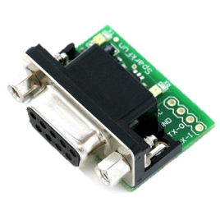
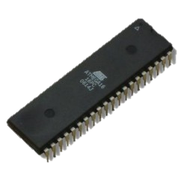





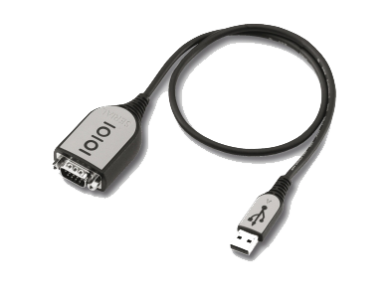
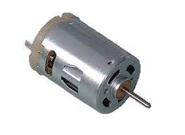
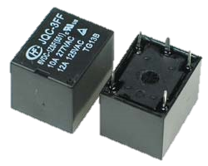


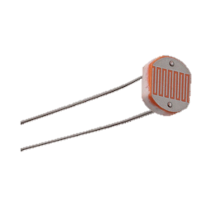
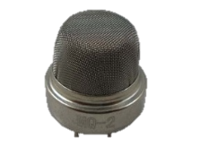
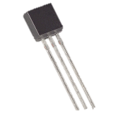
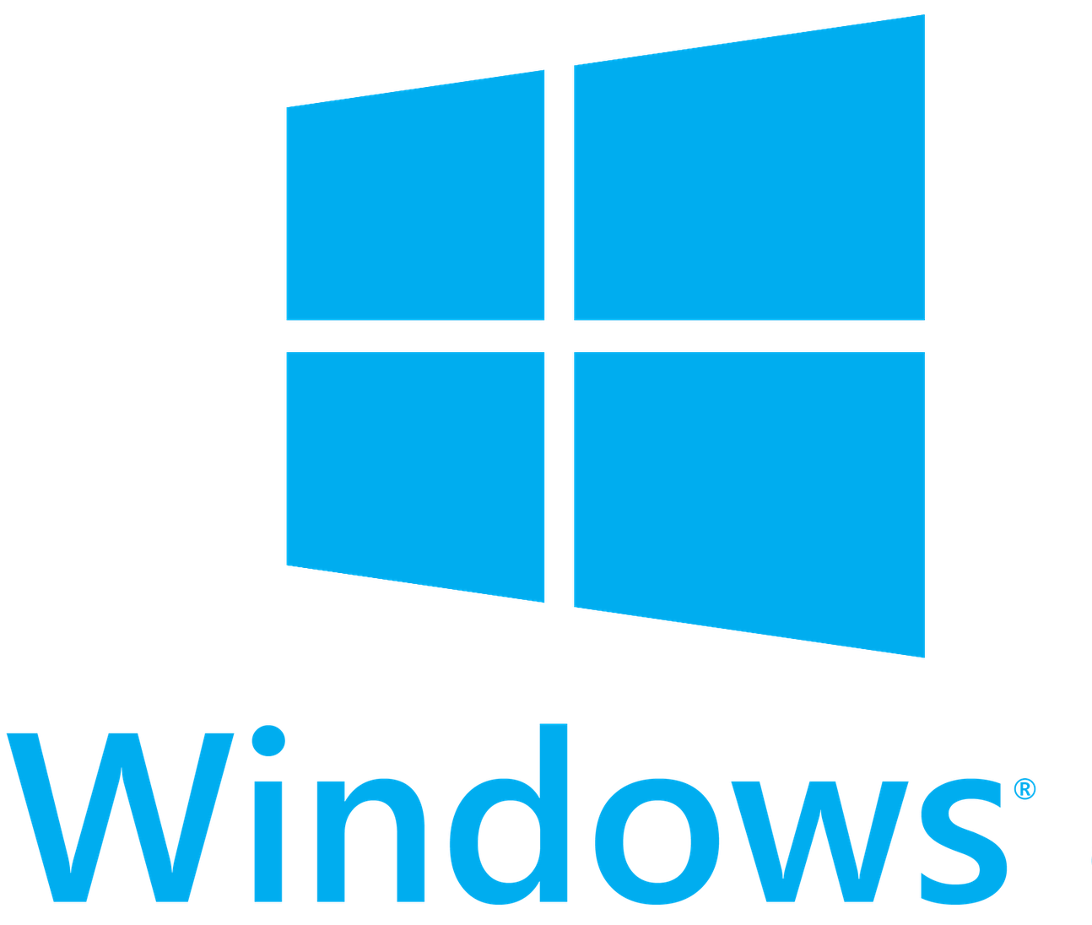
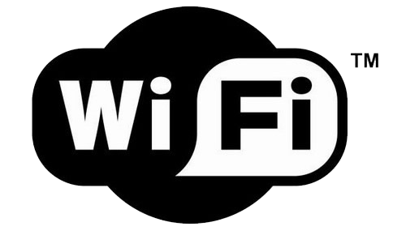

system architecture
Smartphone
Controller
Android Device
Any phone
Remote device

Slide 3
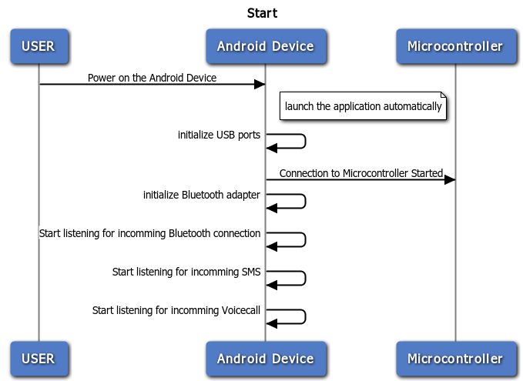
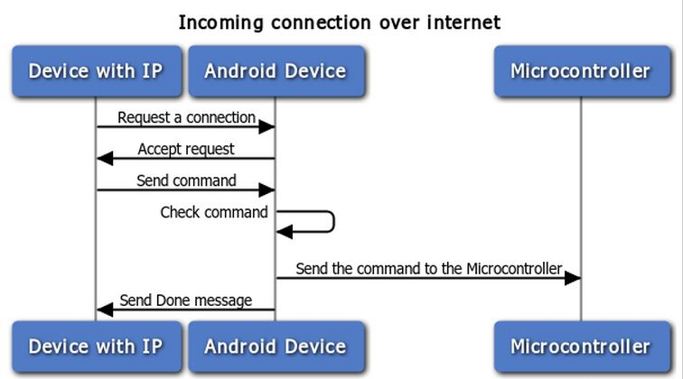
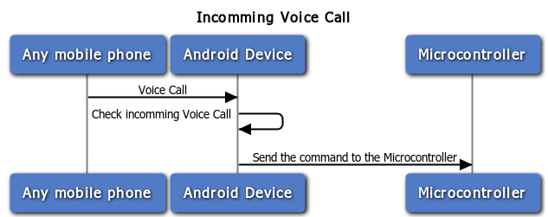
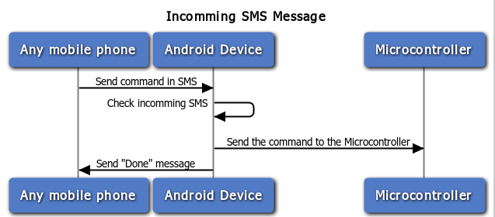
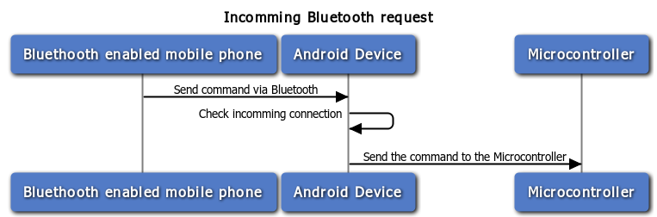
Use cases
Start.
Incoming Bluetooth connection.
Incoming SMS.
Incoming Call.
Incoming Connection over Internet.

Slide 4
Hardware section

Slide 5
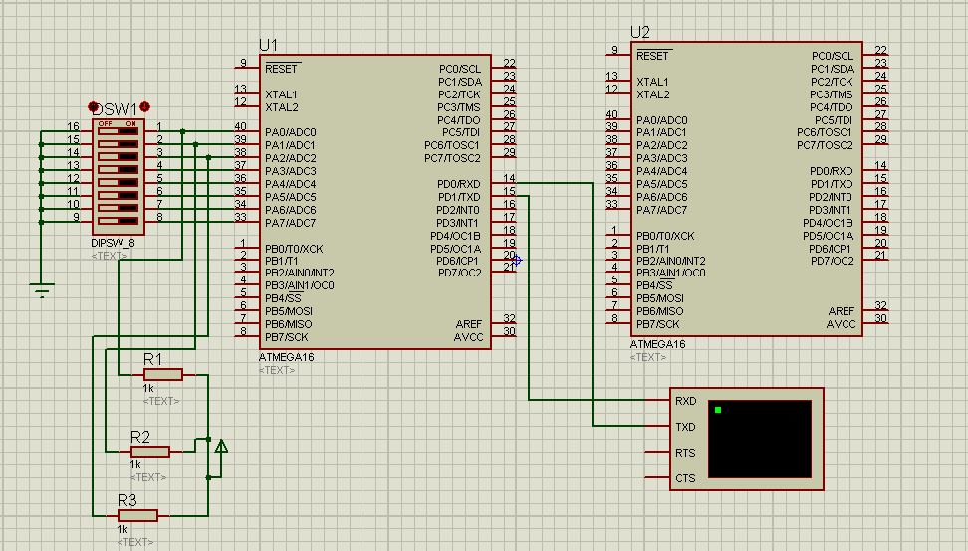
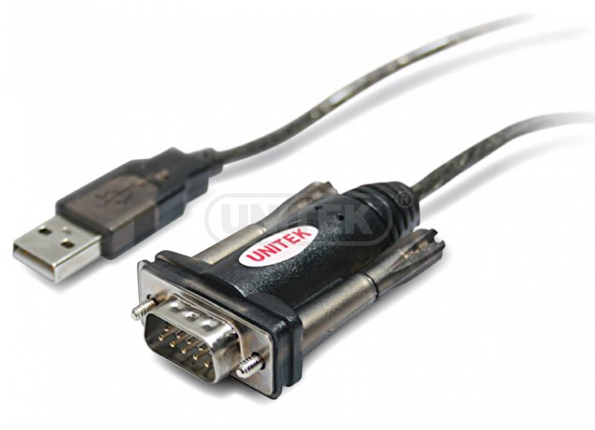
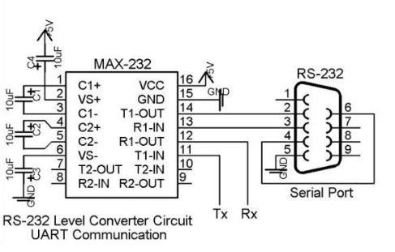
Serial communication
RS232:a Serial port with 9 pins.
MAX232:adapt the RS-232 signal voltage levels to TTL logic, it just needs one voltage (+5V) and generates the necessary RS-232 voltage levels (approx. -10V and +10V) internally.
Converter: A USB-to-RS232 cable.

Slide 6
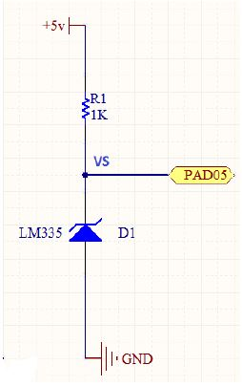
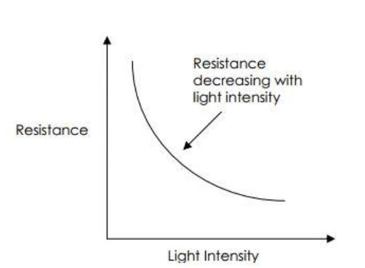
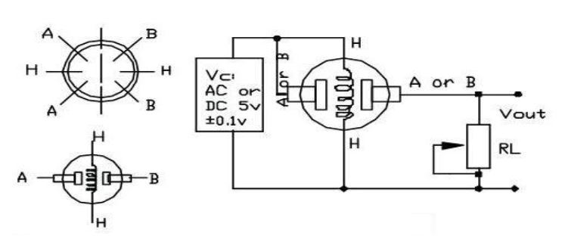
Sensors
LDR is sensitive to light.
Temperature Sensor (LM335): analog sensitive to heat .
Gas Sensor (MQ-5): sensitive to gas, especially methane and propane.

Slide 7
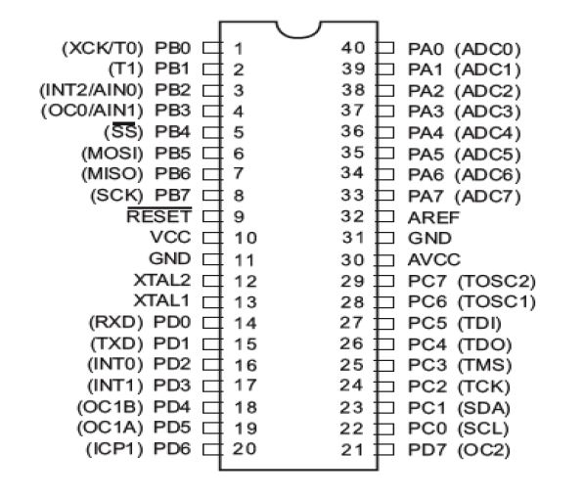
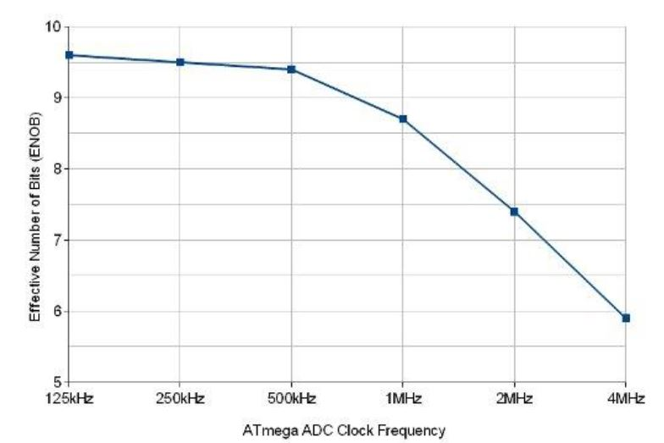

Controller
ATMEGA16A 40 pin:
32 I/O pins:
2 pins for Serial communication (TX,RX) $UBRR=\frac{f}{16 ×BaudRate}−1$
8 ADC pins:
10 bit Resolution.

Slide 8
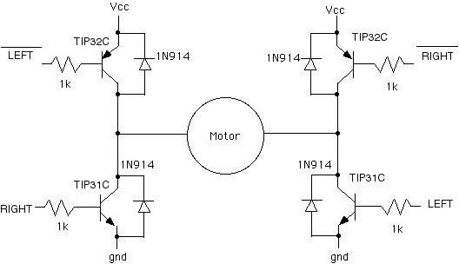
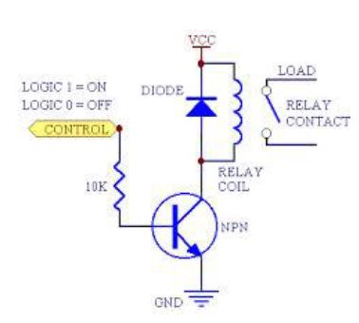
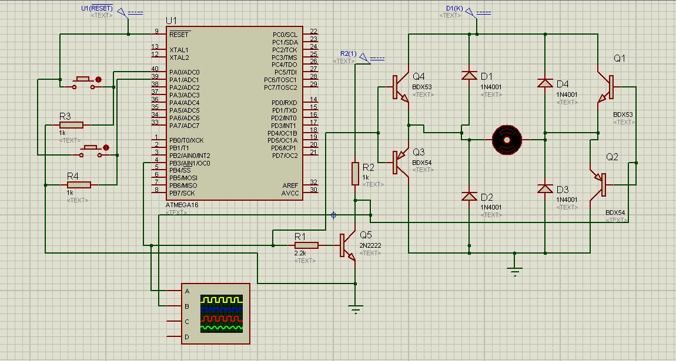
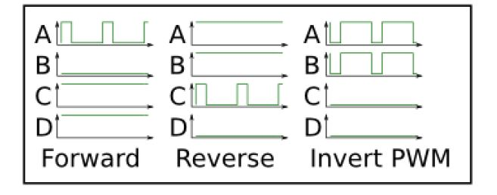
Terminals
Motor: 5V DC motor to simulate a garage door
Pulse width modulation.
H-Bridge Circuit.
Relay: an electrically operated switch which operates a switching mechanism mechanically.

Slide 9
Android user interface application

Slide 10

Application responsibilities
This application control the android lock

Slide 11
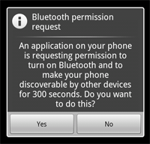
Turn on Bluetooth
The application ask the user To turn on Bluetooth
and Make the device discoverable

Slide 12
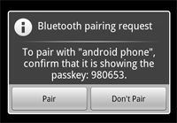
Connect with android device
The application ask the user To pair with android device

Slide 13
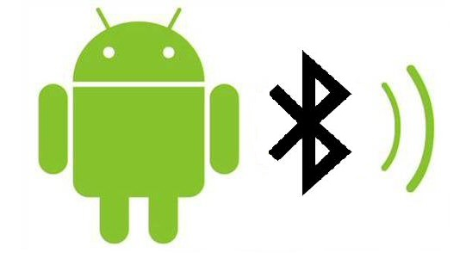

Mechanism of the application
Control Via Bluetooth
Via SMS

Slide 14

Make a call
The application call the android device

